Slide 1

MINI PROJECT ON CAR RENTAL SYSTEM
MOTILAL NEHRU NATIONAL INSTITUTE OF TECHNOLOGY
ALLAHABAD
MASTER OF COMPUTER APPLICATION(IV SEM)
Submitted By:
GROUP-1
Aaditya Supriyo 2016CA90
Aakriti Gupta 2016CA55
Abhishek Gupta 2016CA29
Abhishek Kumar 2016CA04
Abhishek Kr Gautam 2016CA61
Submitted To:
Dr. Anoj Kumar
Associate professor
CSED ,MNNIT, Allahabad

Slide 2
Contents
Motivation
Problem statement
project objective
Features of project
Keyword
Hardware requirement
Software requirement
Modules
DFD
Reference
About project

Slide 3
motivation
People often travel from one place to another for multiple reasons. Not everyone is able to afford a car so they prefer either public transport or carpooling. It also happens that when in need of a vehicle one might not get it on time due to some reasons. Cost is also another issue that is encountered by many travelers. In order to eliminate these issues Car Rental System comes into existence.
3

Slide 4
Problem statement
As the name suggest a Car Rental System enables a person to rent a car according to
one’s need. This system will not only help the traveler rent a car at the lowest prices
possible but also compare the cars (cost, brand, and model). It will provide the details of
the cars that are available in the nearest area, pickup location as well as its drop location.
The individual in need of a car must contact the owner regarding the vehicle. The person
renting the car will also provide feedback to the owner. Before renting the car all the
details of the renter will be verified.
4

Slide 5
PROJECT OBJECTIVE
It is a system design specially for large, premium and small car rental business. The car rental system provides complete functionality of listing and booking car.

Slide 6
HARDWARE REQUIREMENT
1 GB RAM and above
Minimum Hard Disk: 20 GB
Processor Intel-Core (I3 Processer, Dual Core Processor and above)
1280 X 800 Minimum Screen Resolution
Internet enabled device
GPS

Slide 7
SOFTWARE REQUIREMENT
IDE: Net Beans
Technology: JSP Servlet
Tom cat server
Back End:MySQL
Operating System: Windows XP and above / LINUX
Front End: HTML 5, CSS,Bootstrap,JavaScript
Browser: Chrome, Firefox and other browsers.

Slide 8
MODULES
1 REGISTRATION
1.1 Signup For Customer and Renter
1.2 Login for Customer and Renter
1.3 Change Password / Forgot Password
1.4 Help
1.5 About Us

Slide 9
COntd….
2 CUSTOMER
2.1 Edit Profile
2.2 Search Car
2.3 Book Car
2.4 Duration of Trip
2.5 Pick-up Date
2.6 Drop off Date
2.7 Booking Detail
2.8 Payment History
2.9 Feedback

Slide 10
COntd….
3 RENTER
3.1 Edit Profile
3.2 Add Vehicle
3.3 Remove Vehicle
3.4 Update Information
3.5 Booking Details
3.6 Duration of Trip
3.7 Pick-up Date
3.8 Drop off Date
3.9 GPS Tracker
3.10 Payment History

Slide 11
COntd….
4 ADMIN
4.1 Login
4.2 Manage Customer
4.3 Manage Renter
4.4 Manage Bookings

Slide 12
contd….
5 REPORT
5.1 Report Customer
5.2 Report Renter
5.3 Report Vehicle

Slide 13
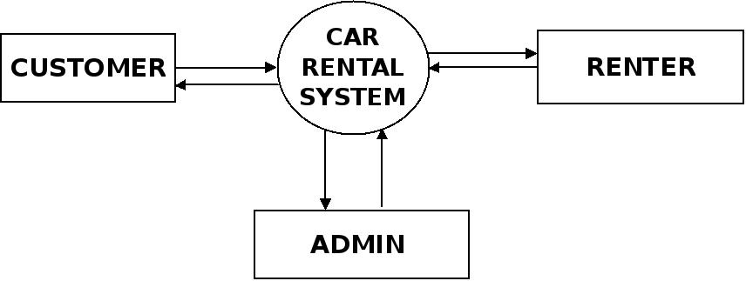
DATA FLOW DIAGRAM
Zero level DFD

Slide 14
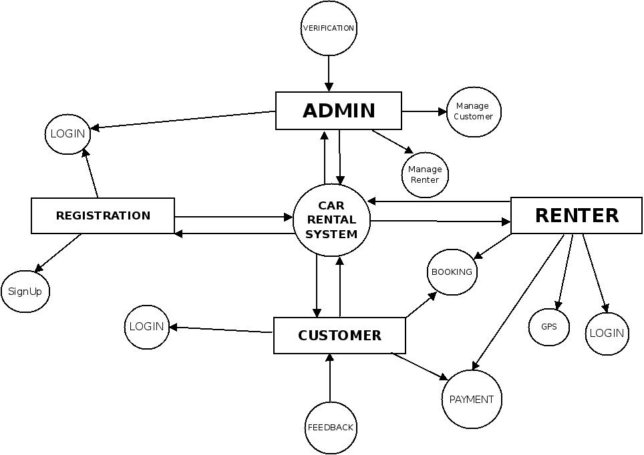
First level dfd

Slide 15
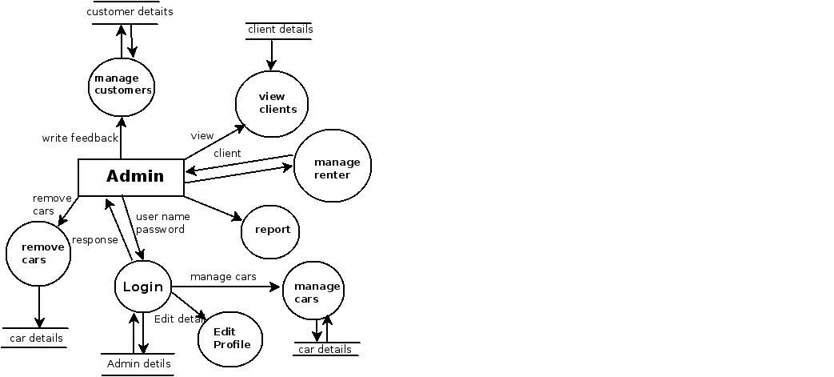
Second level dfd(admin)

Slide 16
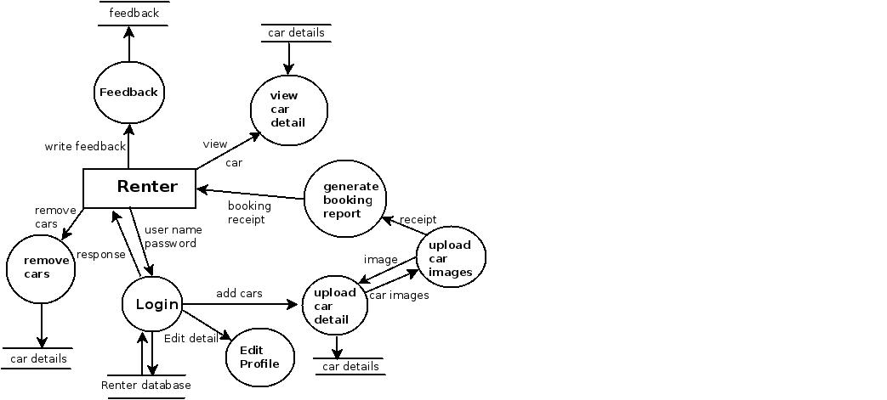
Second level dfd (renter)

Slide 17
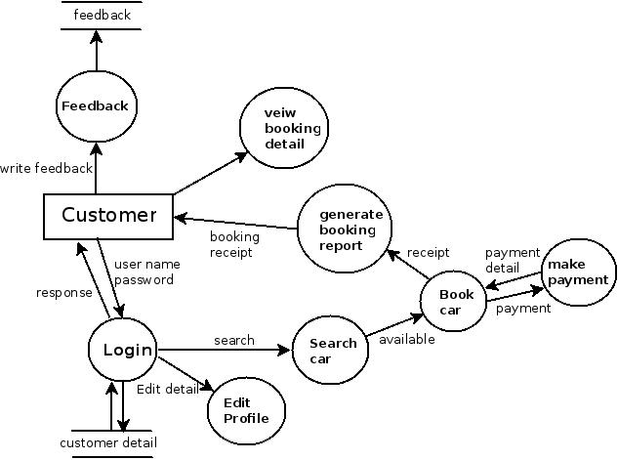
Second level dfd(customer)

Slide 18
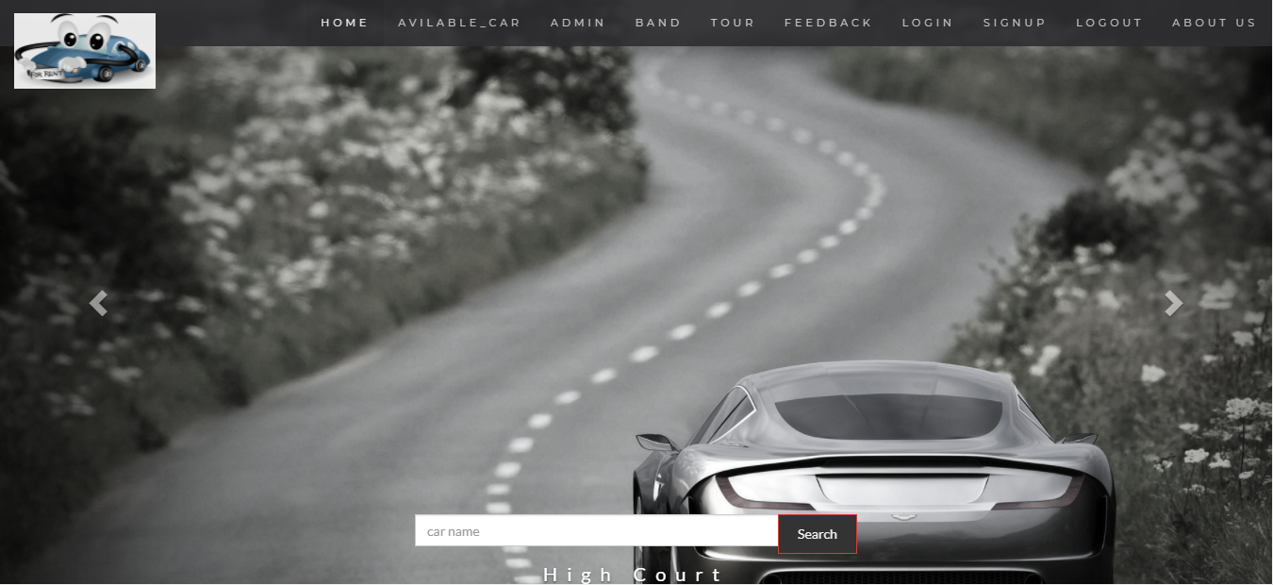

Slide 19
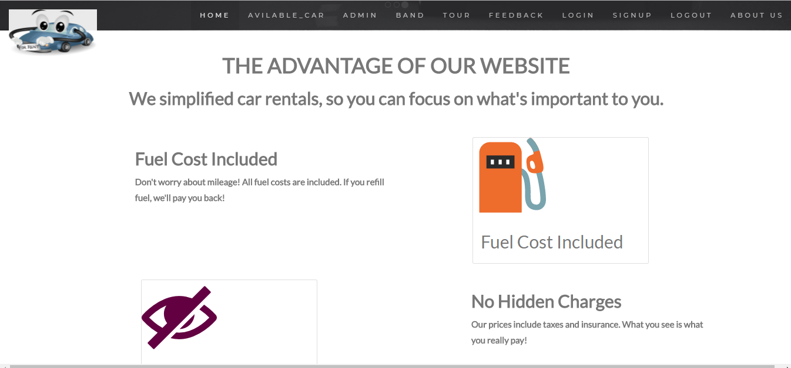

Slide 20
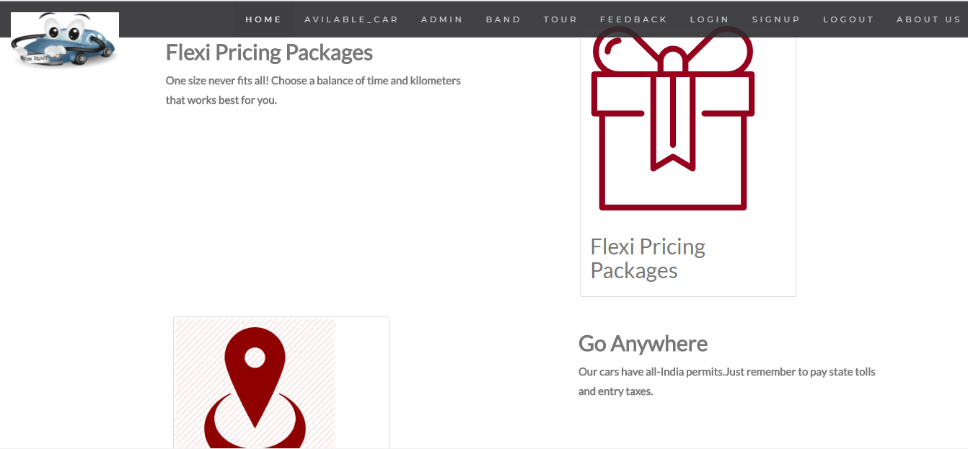

Slide 21
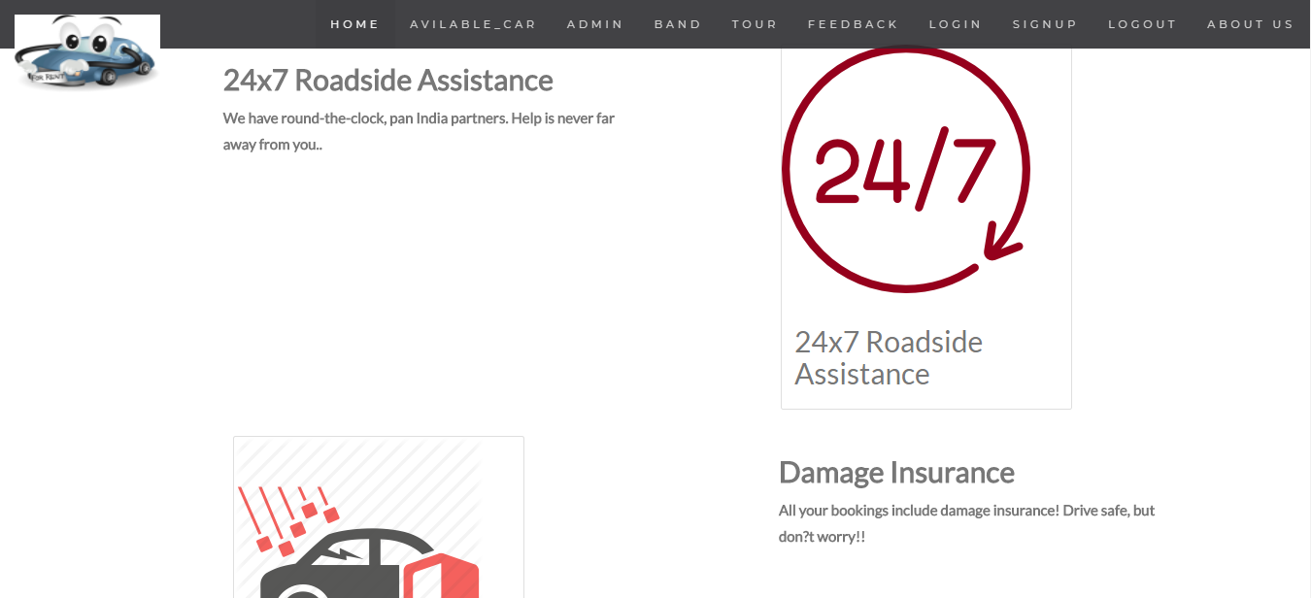

Slide 22
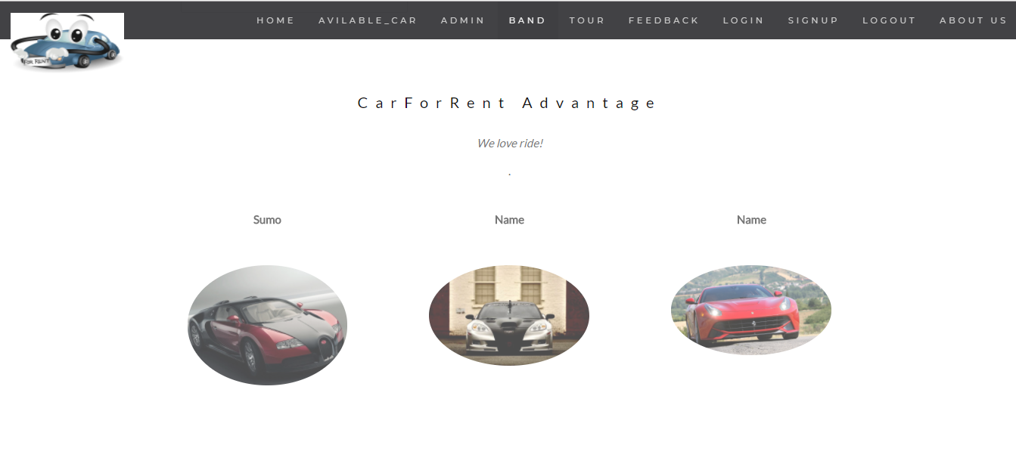

Slide 23
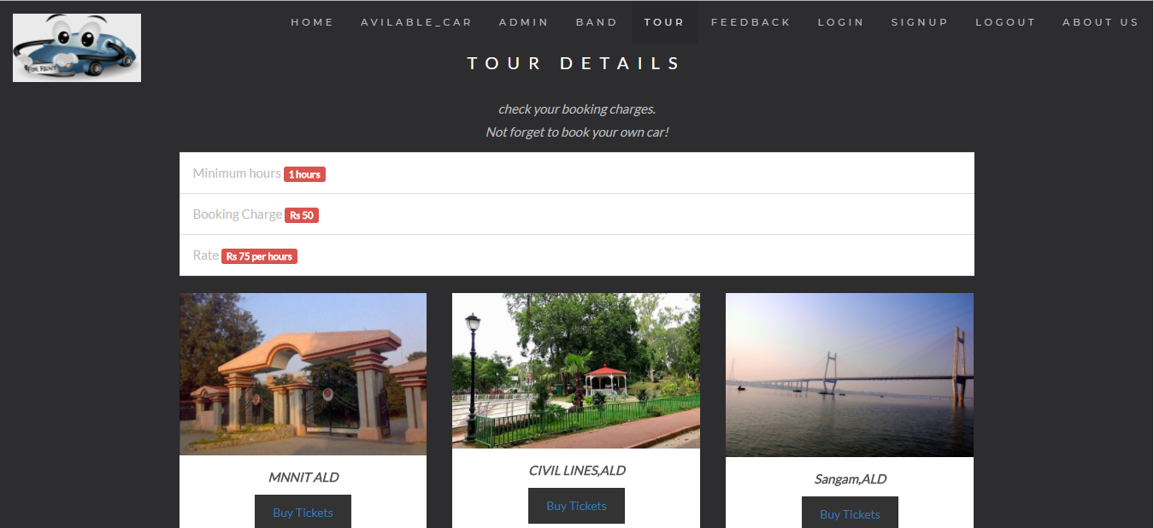

Slide 24
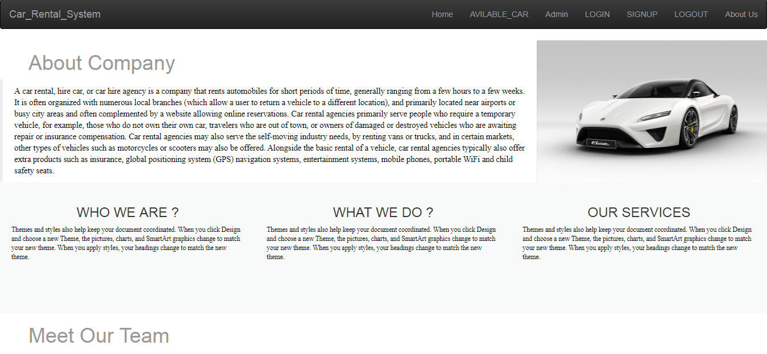

Slide 25
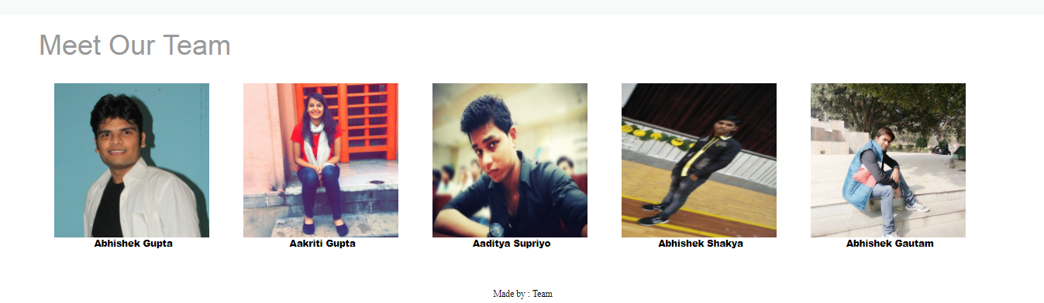

Slide 26
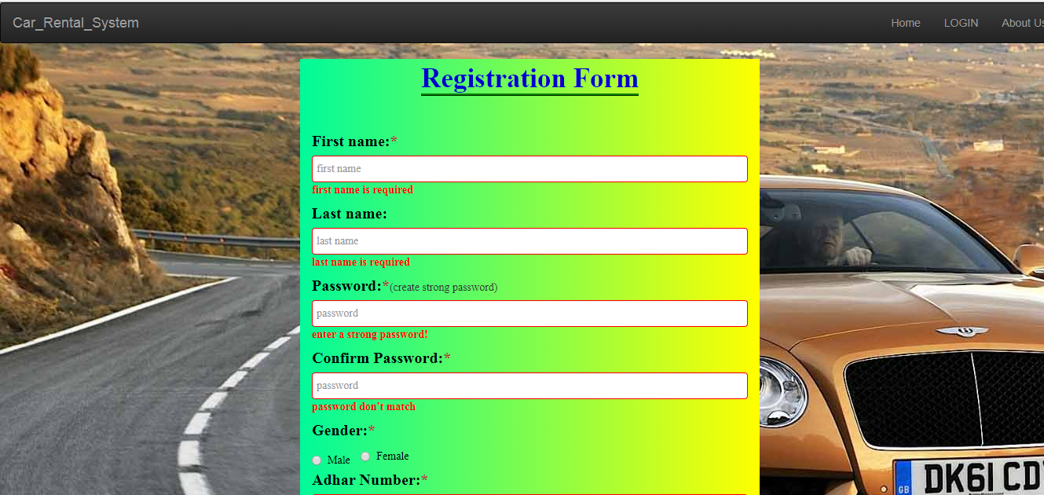

Slide 27
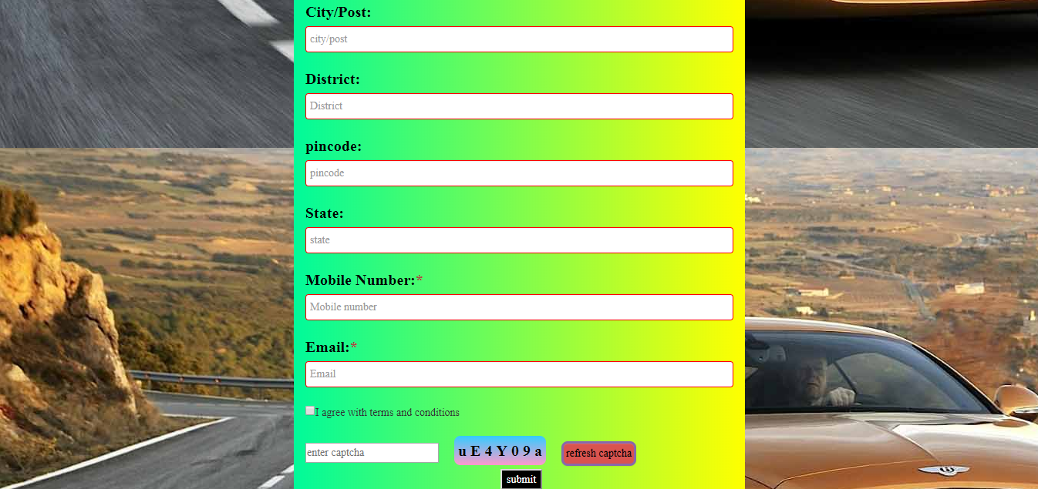

Slide 28
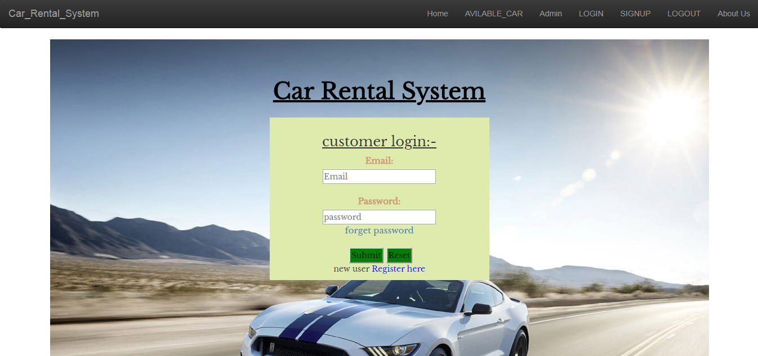

Slide 29
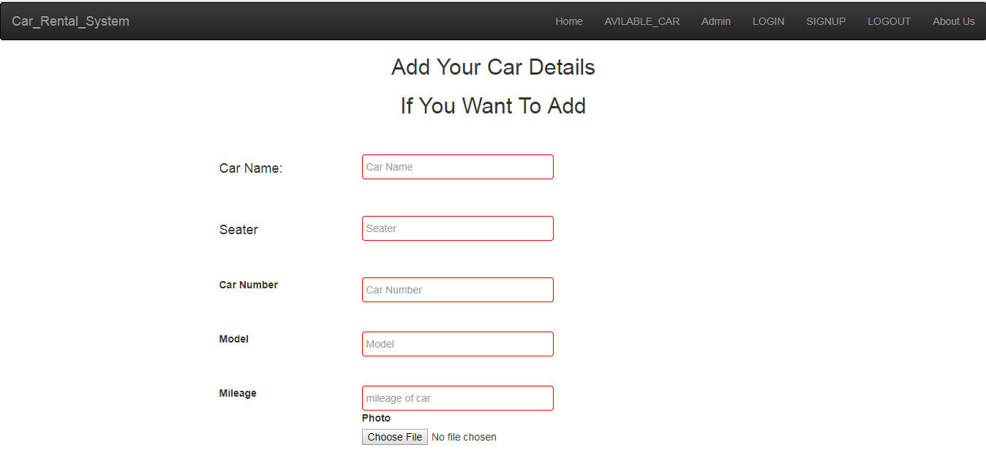

Slide 30
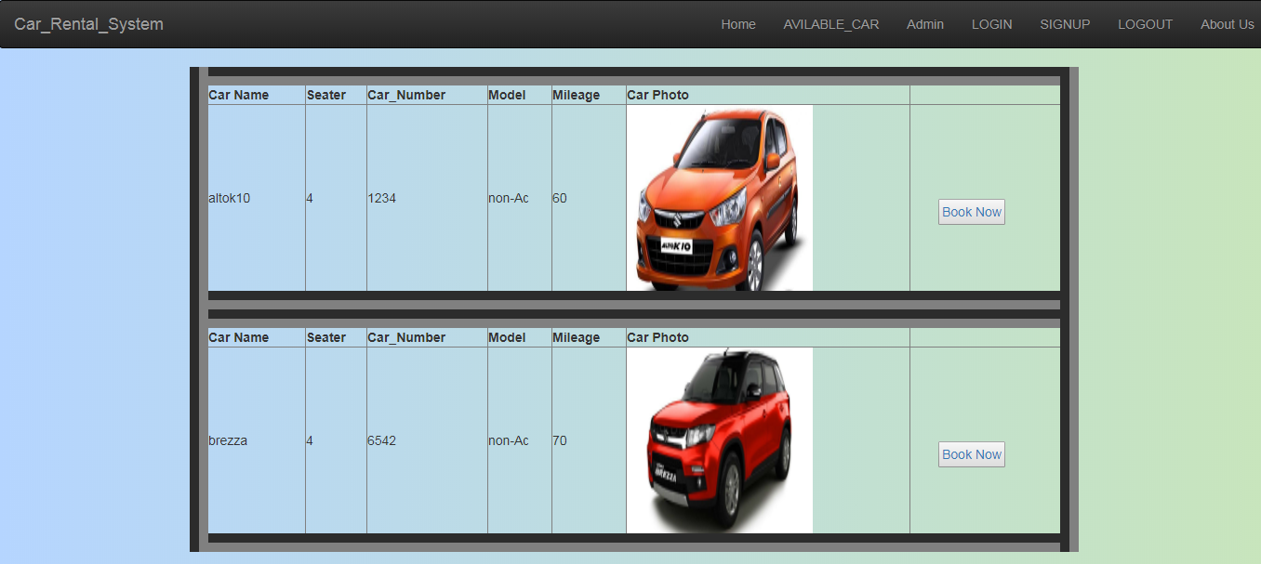

Slide 31
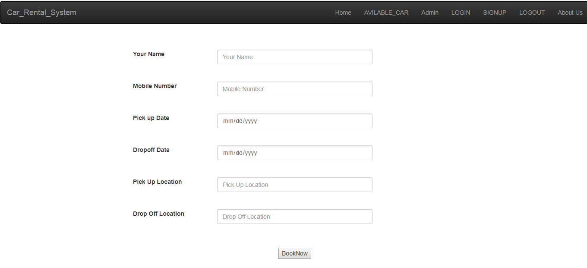

Slide 32
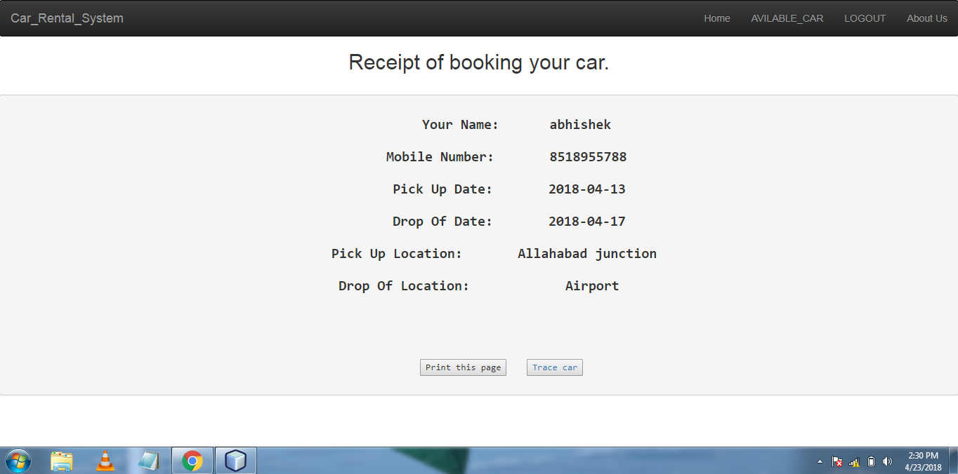

Slide 33
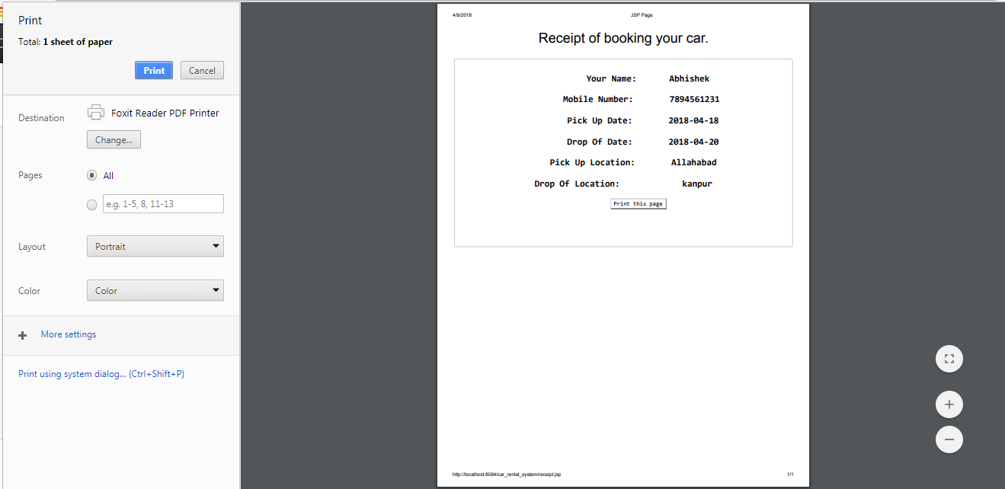

Slide 34
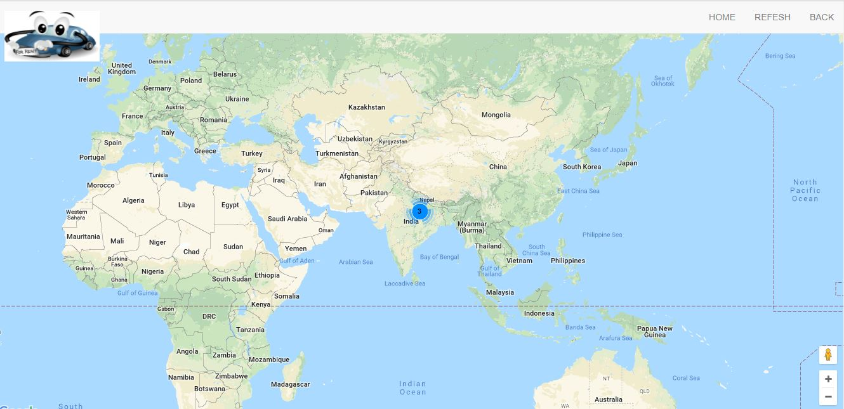

Slide 35
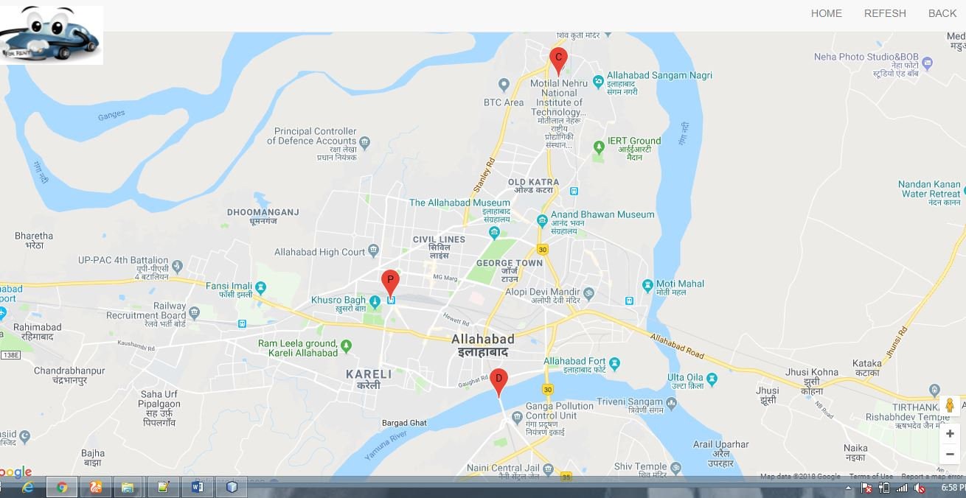

Slide 36
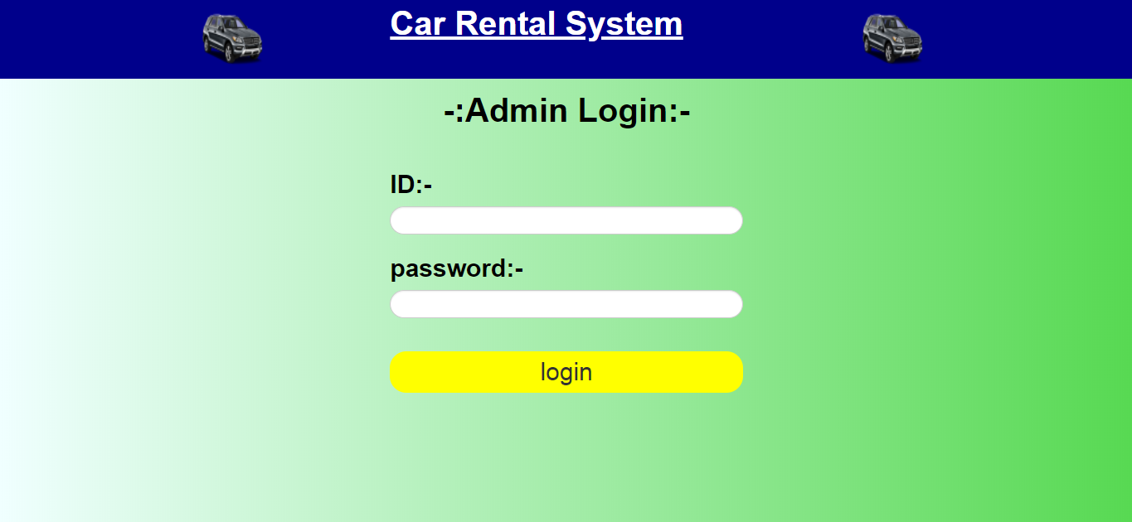

Slide 37
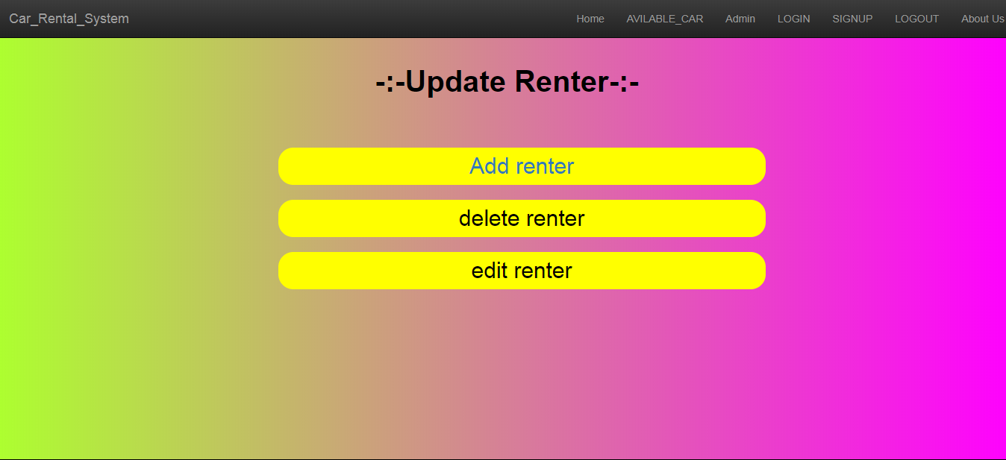

Slide 38
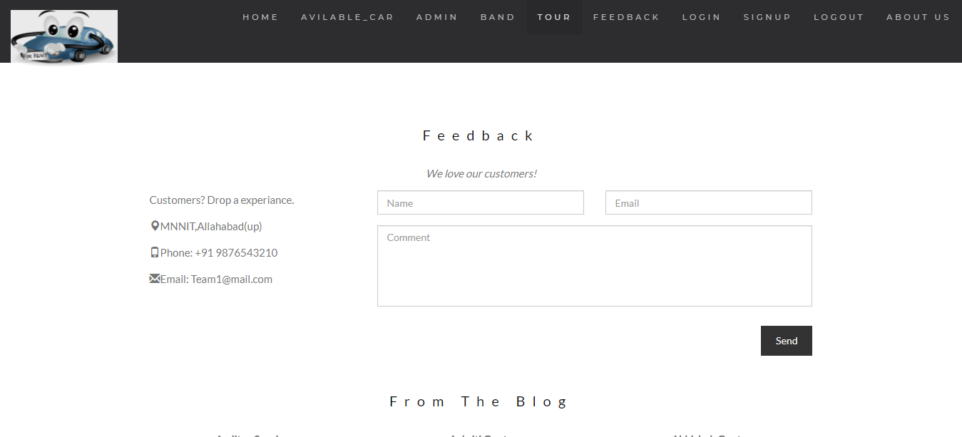

Slide 39
References
https://www.google.co.in/
http://www.rentalcars.com/
https://codecanyon.net/item/car-rental-system-native-wordpress-plugin/11758680
http://gnu.inflibnet.ac.in/bitstream/123456789/2214/1/ONLINE%20CAR%20RENTAL%20SYSTEM.pdf

